Slide 1
Cars Can’t Fly up in the Sky:
Improving Urban-Scene Segmentation via
Height-driven Attention Networks
Sungha Choi^{1,3} Joanne T. Kim^{2,3} Jaegul Choo⁴
¹A&B Center, LG Electronics, Seoul, South Korea ²Lawrence Livermore National Laboratory, Livermore, CA, USA
³Korea University, Seoul, South Korea ⁴KAIST, Daejeon, South Korea
CVPR 2020
Speaker: Cong Fang

Slide 2
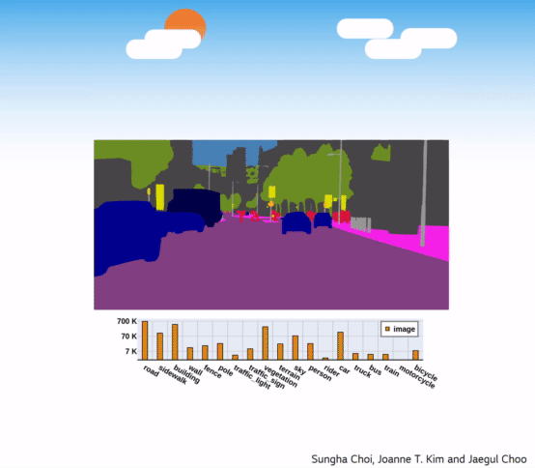
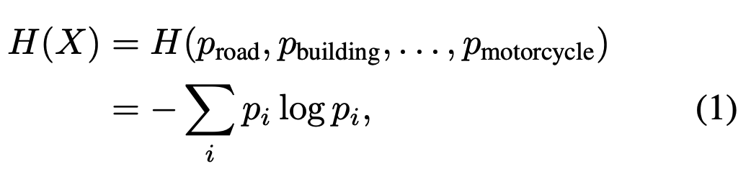
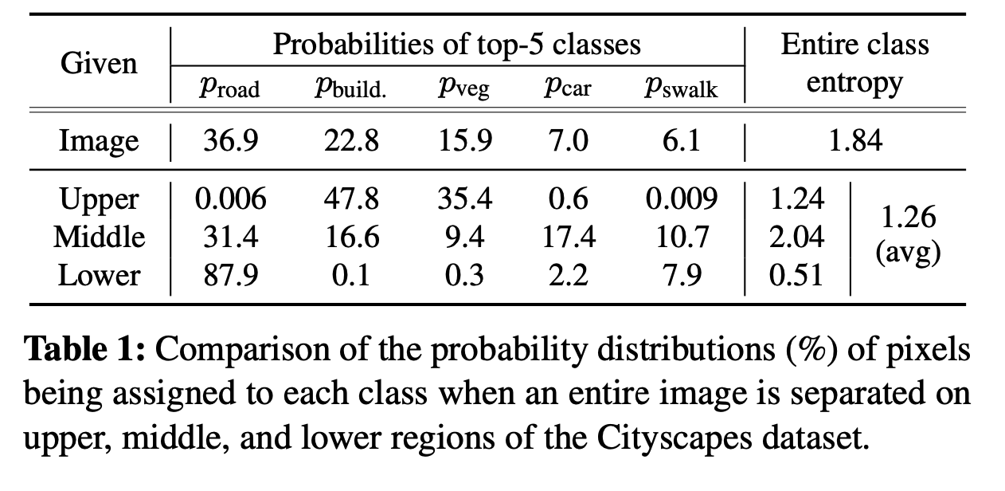
Motivation
Human already knows the fact that Urban-scene images have their own distinct structural priors
If we divide image into several horizontal sections, the class distribution is completely different
Each horizontal section has different dominant classes and the average entropy decreases

Slide 3
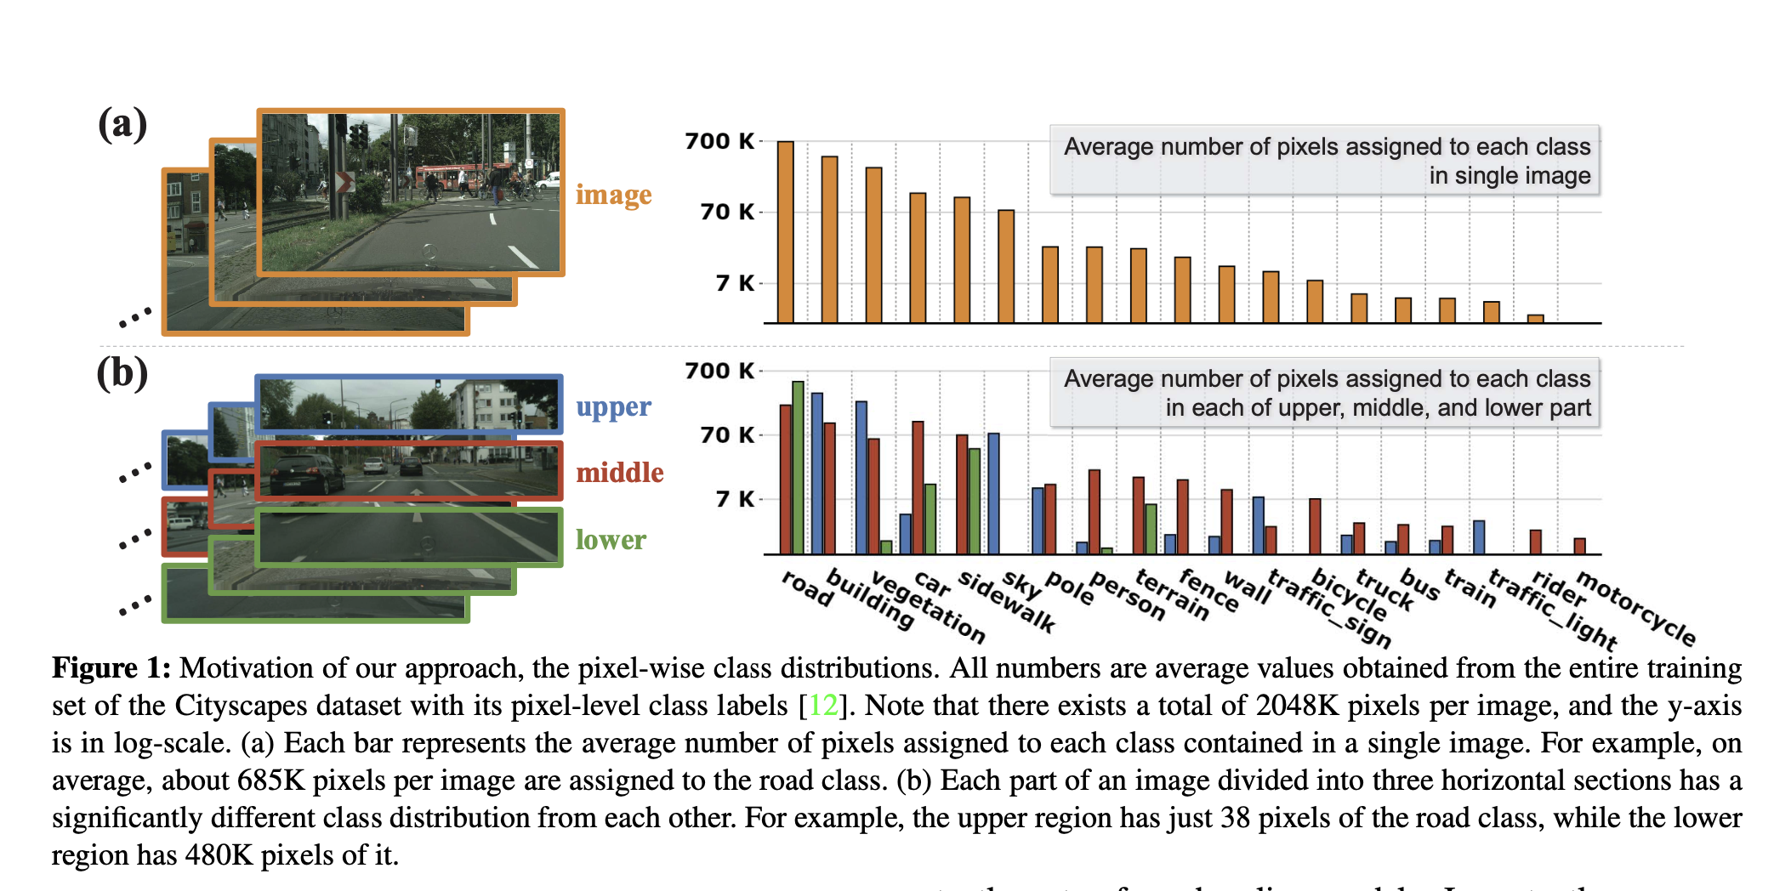
Contributions
Propose a lightweight add-on module: HANet, improves the performance by scaling the activation of channels according to the vertical position of a pixel.
Visualize and interpret the attention weights on individual channels to experimentally confirm our intuition and rationale that height position is crucial to improve the segmentation performance on urban scene.

Slide 4
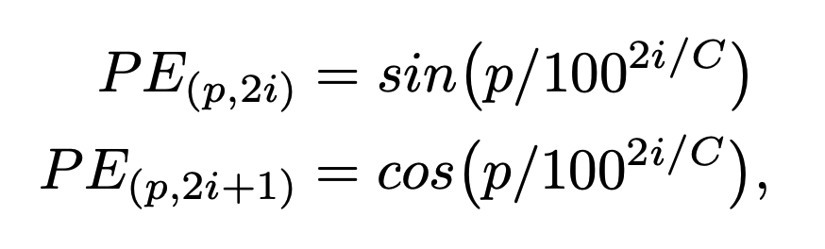
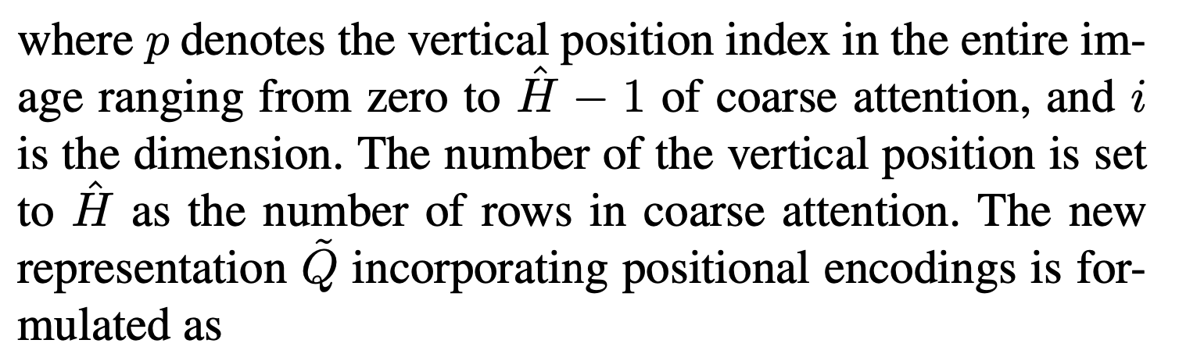
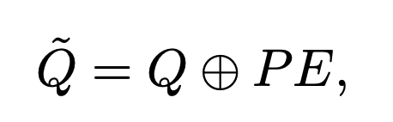
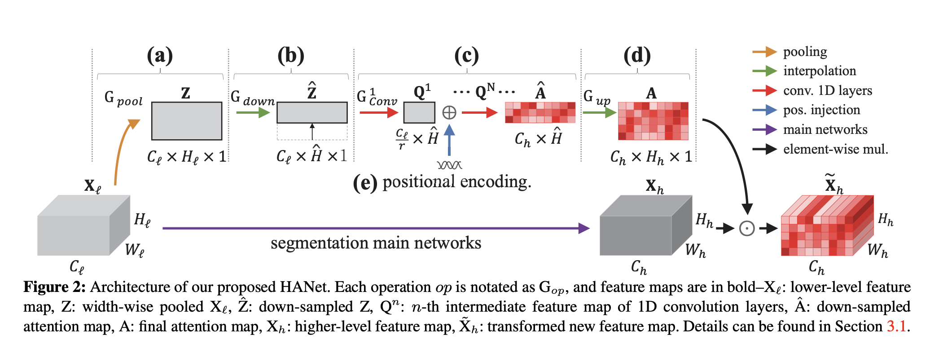
Method

Slide 5
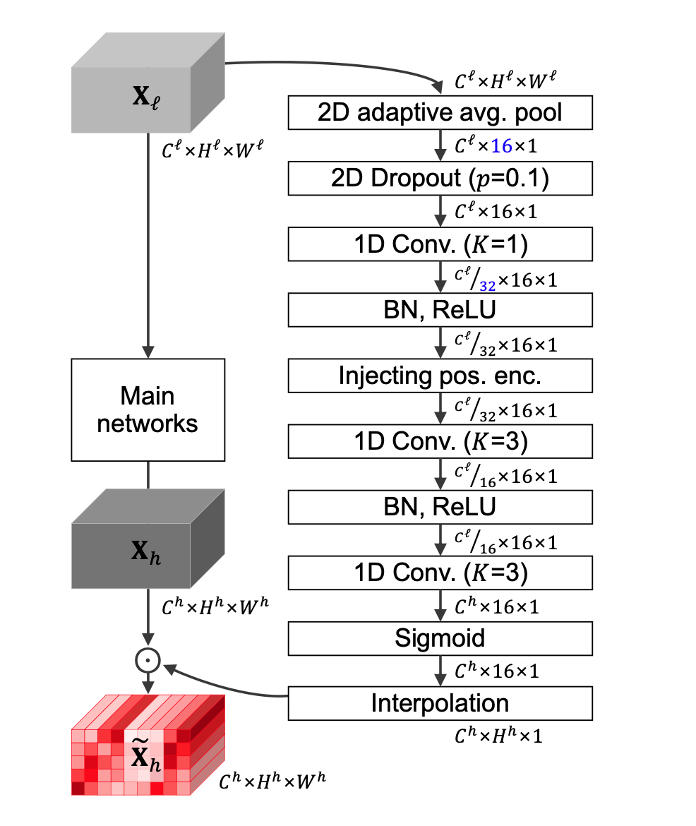
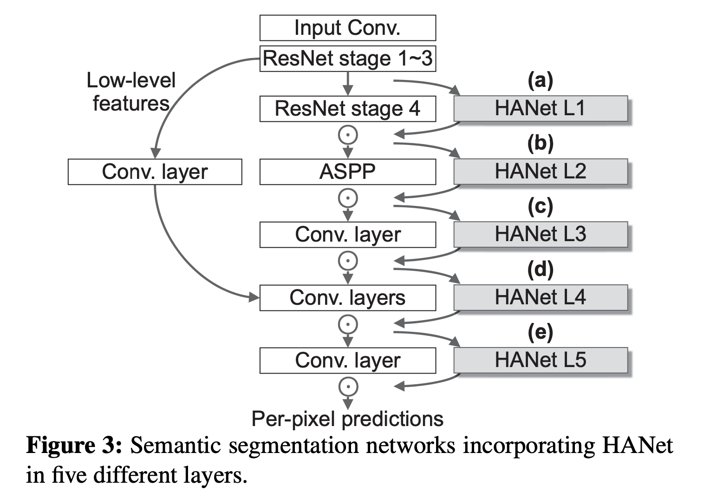
Method

Slide 6
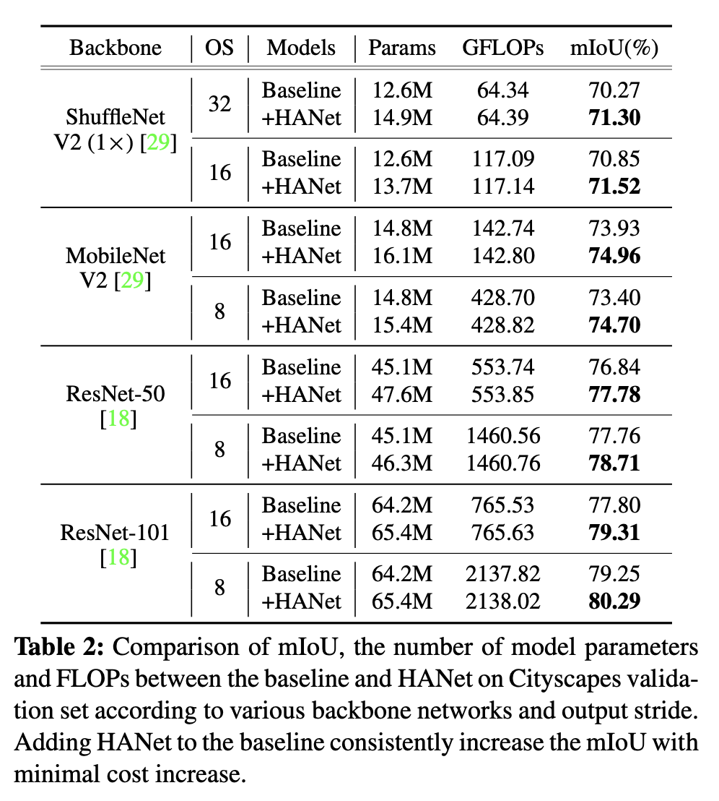
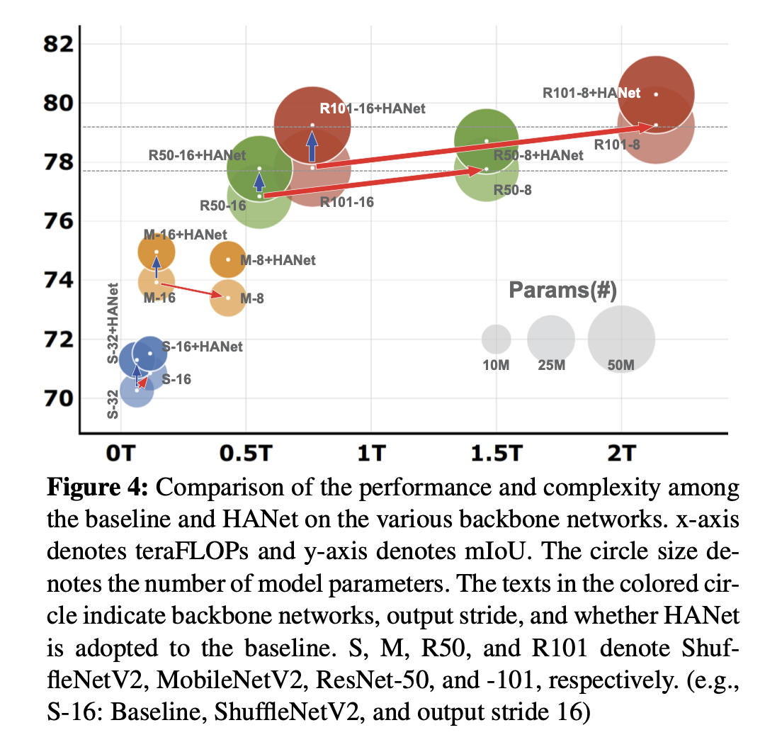
Experiments
Datasets:
Cityscapes
BDD100K

Slide 7
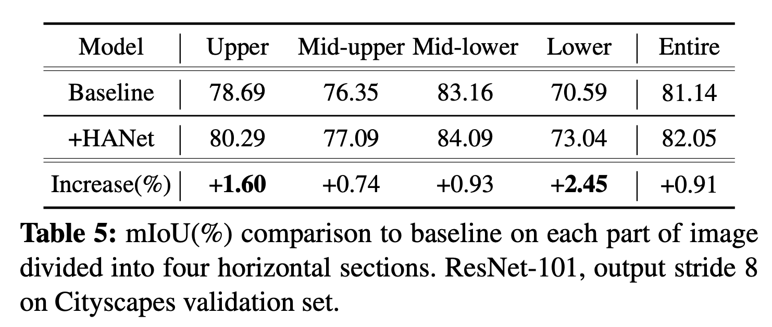
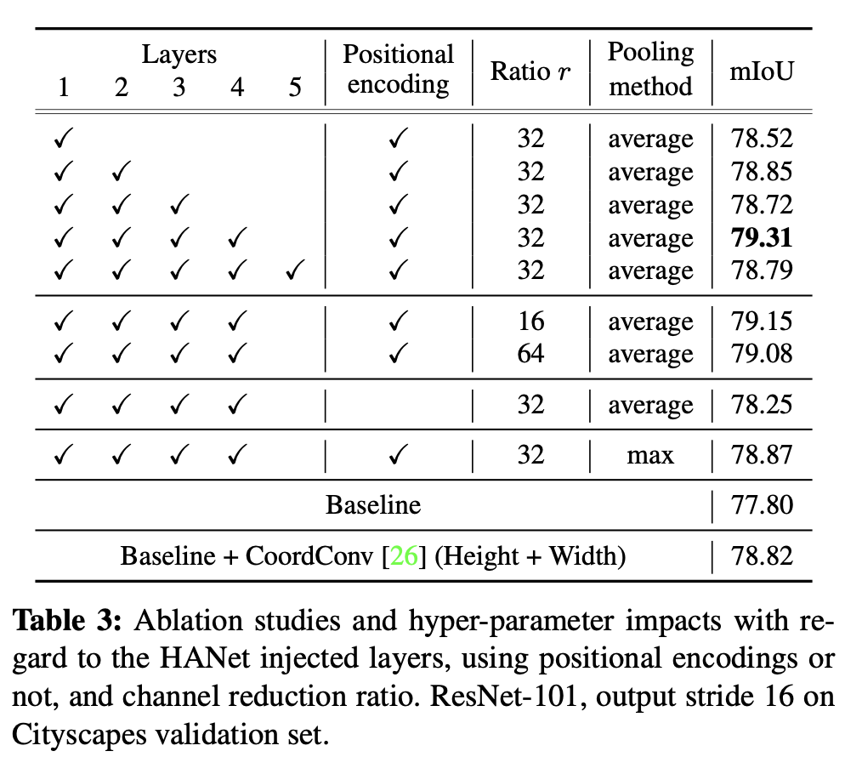
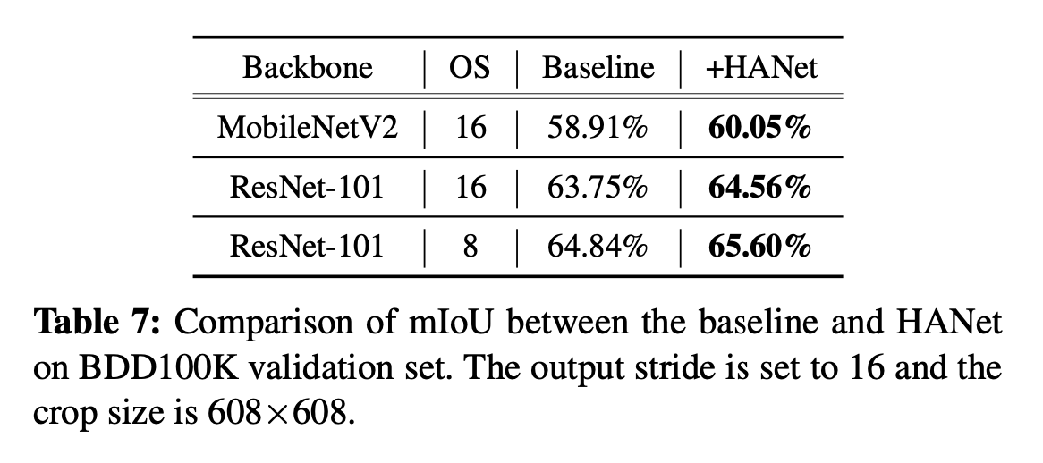
Experiments

Slide 8
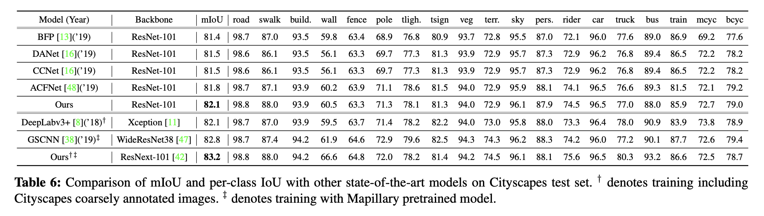
Experiments

Slide 9
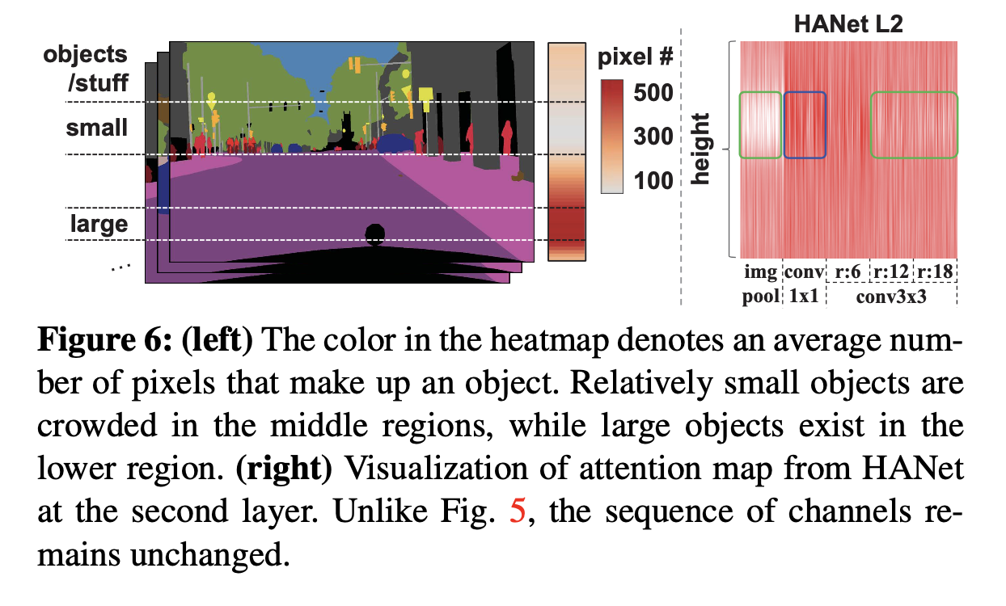
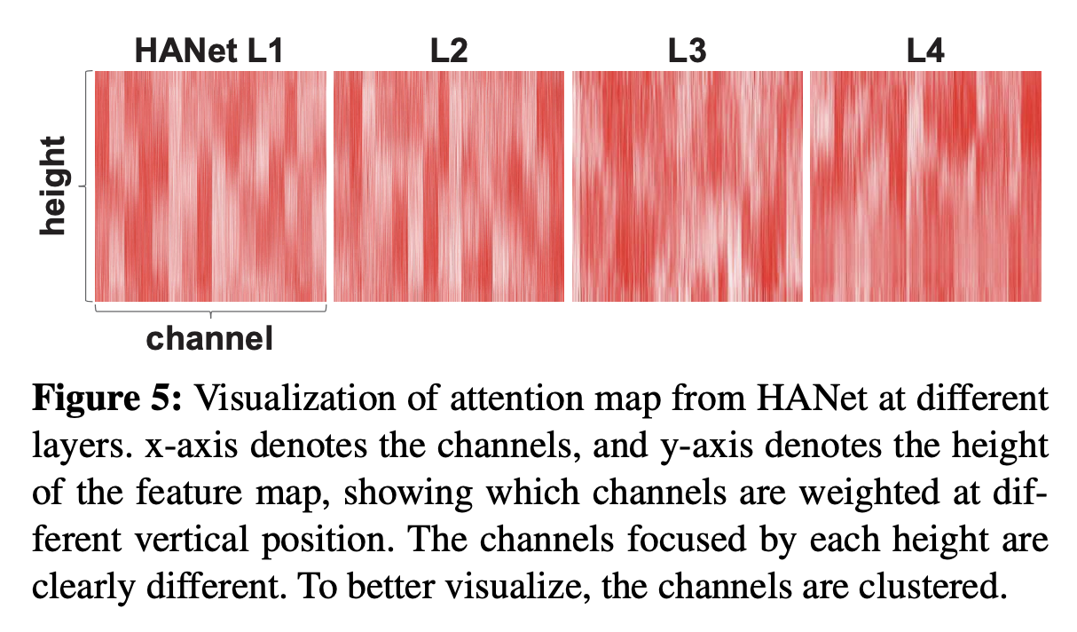
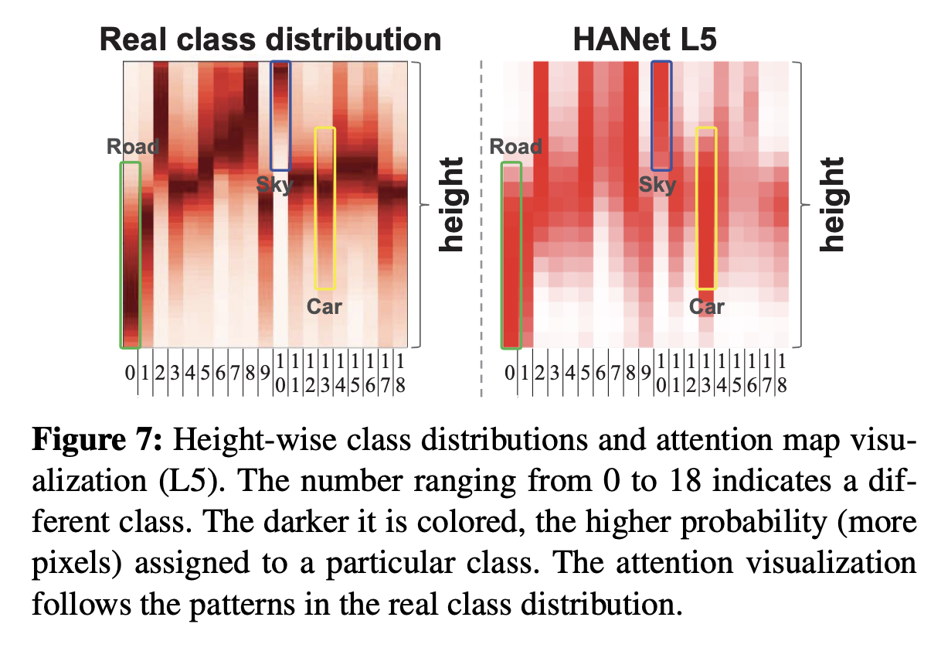
Qualitative Analysis

